Slide 1

Xamarin University
(Web Services)
Lecture will begin soon
Please log into your lab environment using the instructions provided via email
Please join in the conversation as we wait for the course to begin

Slide 2
Lecture 9
Integrating SOAP and RESTful Web Services

Slide 3
Module Objectives
Build a client for SOAP web services
Build a client for RESTful web services
Build a REST client for multiple platforms

Slide 4
Lab 1
Integrating SOAP and RESTful web services

Slide 5
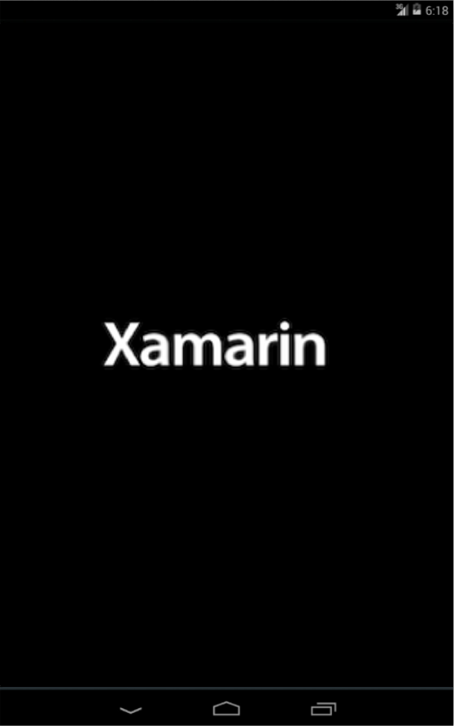
Lab Objectives
Consume a WSDL
Generate a SOAP client
Map web service DTOs to models
Integrate web service with UI

Slide 6
Let’s Get Started
Building a SOAP web service client

Slide 7
Lab Summary
Consumed a WSDL
Generated a SOAP client
Mapped web service DTOs to models
Integrated web service with UI
Questions?

Slide 8
Lab 2
Building a RESTful web service client

Slide 9
Module Objectives
Setup a RESTful client
Call a RESTful web service
Map web service DTOs to models
Integrate web service with UI

Slide 10
Let’s Get Started
Building a RESTful web service client

Slide 11
Lab Summary
Setup a RESTful client
Called a RESTful web service
Mapped web service DTOs to models
Integrated web service with UI
Questions?

Slide 12
Xamarin University
Integrating SOAP and RESTful Web Services
Thank You

